Slide 1
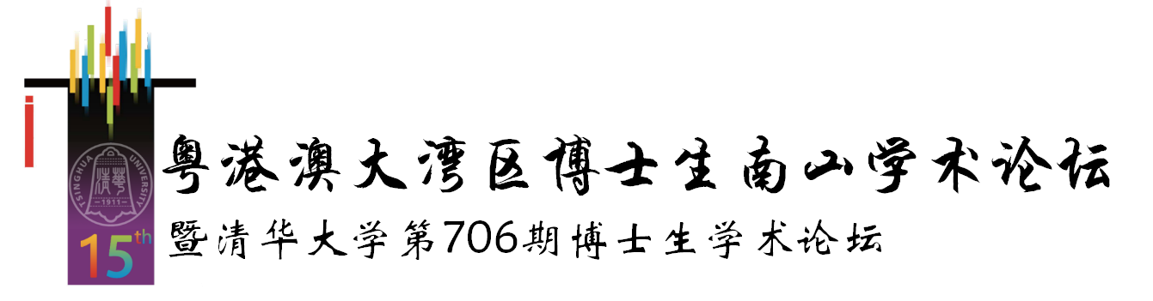


H-SwarmLoc:
Efficient Scheduling for Localization of Heterogeneous MAV Swarm with Deep Reinforcement Learning
Haoyang Wang^{1*}, Xuecheng Chen^{1*}, Yuhan Cheng¹, Chenye Wu², Fan Dang¹, Xinlei Chen¹
Tsinghua University¹, The Chinese University of Hong Kong, Shenzhen²
Notes:
Hello, everyone. I am Haoyang Wang from Tsinghua Berkeley Shenzhen Institute, and I am honored to have this opportunity to present our work in heterogeneous MAV swarm, on the behalf of my coauthors from both Tsinghua University, and The Chinese University of Hong Kong, Shenzhen. Our work is dedicated to achieve high accuracy localization of micro aerial vehicle at low cost, which is also known as MAV swarm

Slide 2
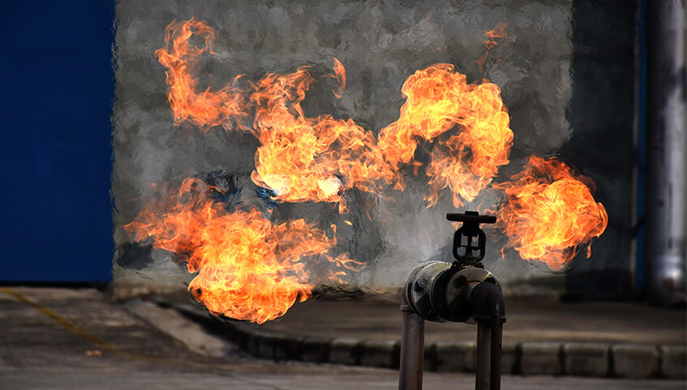
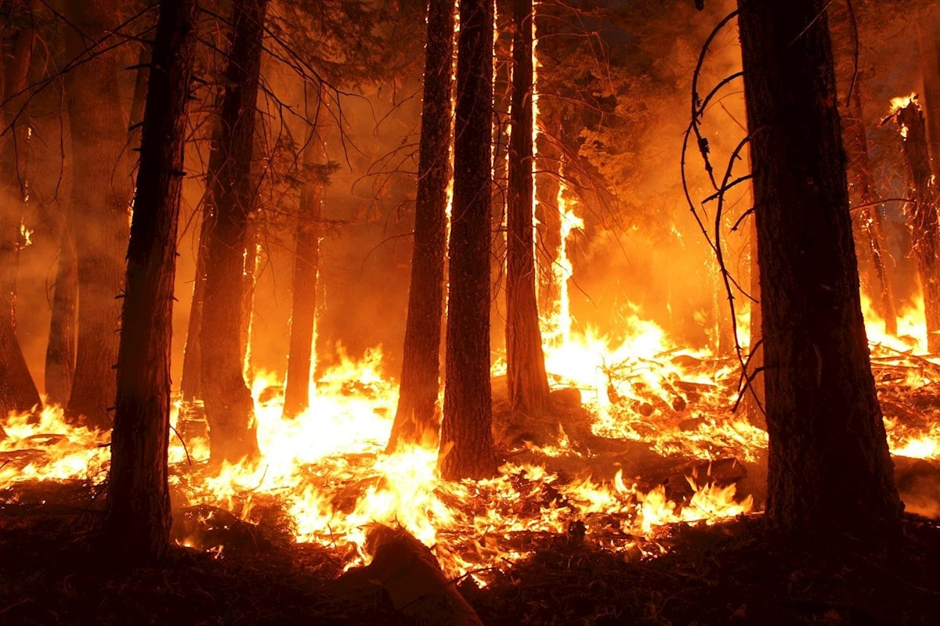
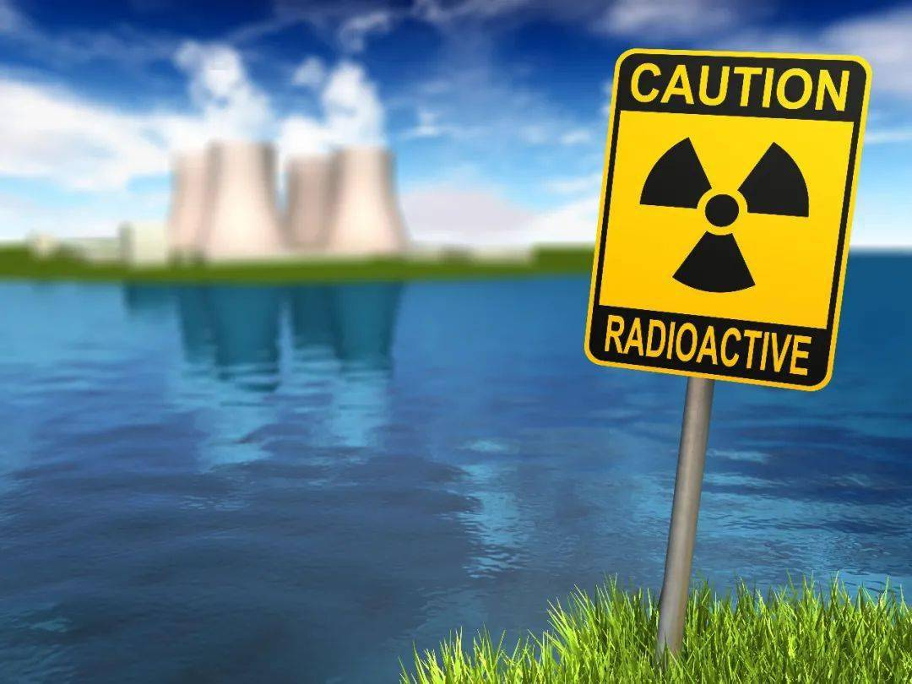
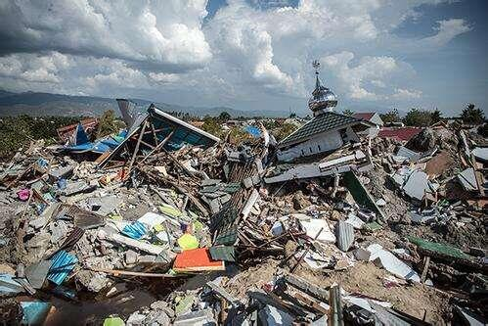
Situational Awareness Sensing in Dangerous Areas
Allows rescuers to draw up effective strategies to minimize the loss of life
Gas Leak
Forest Fire
Nuclear Radiation
Earthquakes
Notes:
Emergency response scenarios, including gas leaks, nuclear radiation, forest fires and earthquakes, are considered hazardous due to the complexity of the operating environment. Rescuers have little prior information about the environment, which may cause inefficient subsequent rescue operations, even death.

Slide 3
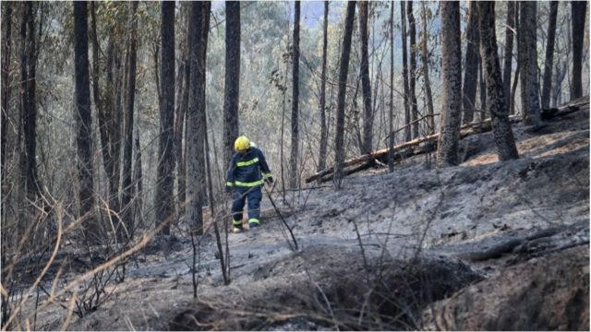
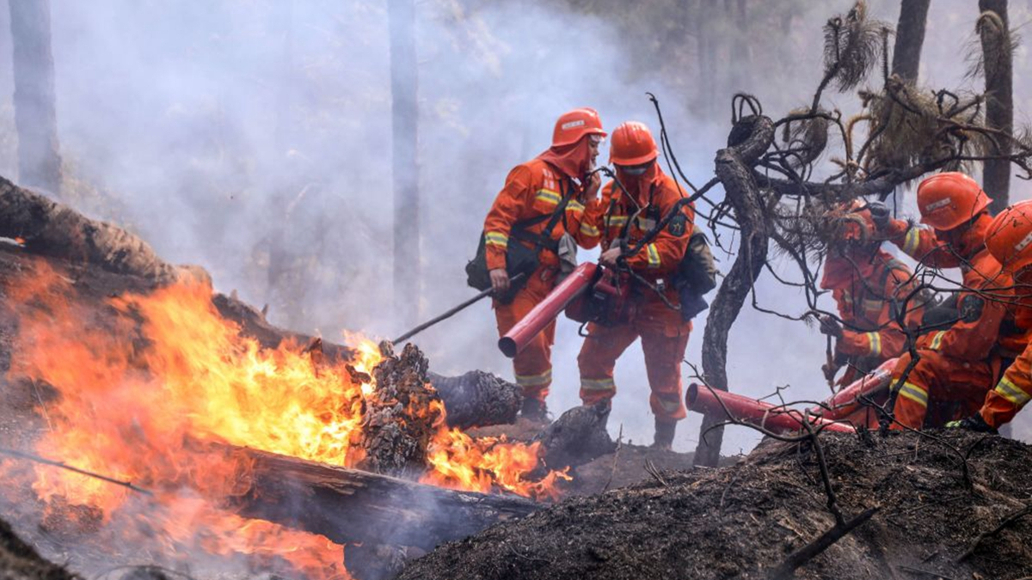
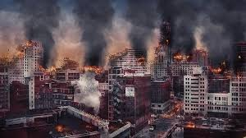
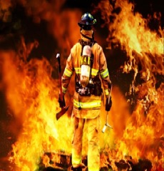

Situational Awareness Sensing in Dangerous Areas
Allows rescuers to draw up effective strategies to minimize the loss of life
Xichang, Sichuan, China
2022 Marth, 19 death
Muli, Sichuan, China
2019 Marth, 30 death
Gas Leak
Forest Fire
~3.7 million
~180K
safe routes?
fire/year
death/year
dangerous areas?
Nuclear Radiation
Earthquakes
locations of survivors?
https://www.bbc.com/zhongwen/simp/chinese-news-52208183
Notes:
For example, in 2019 and 2022, 30 and 19 firefighters are buried in fires in Sichuan, China. Actually, 3.7 million fires and 180K deaths, occurs each year, which is a heartbreaking number. The reason for this is that, firefighters don't know the environment, they don't know safe routes, dangerous areas and locations of survivors.

Slide 4
Situational Awareness Sensing in Dangerous Areas
Allows rescuers to draw up effective strategies to minimize the loss of life
Xichang, Sichuan, China
2022 Marth, 19 death
Muli, Sichuan, China
2019 Marth, 30 death
Gas Leak
Forest Fire
~3.7 million
~180K
safe routes?
fire/year
death/year
dangerous areas?
Nuclear Radiation
Earthquakes
locations of survivors?
Need for Fine-grained Real-time environmental info.
Notes:
If they had access to Fine-grained, Real-time environmental information in advance, the situation would have been very different

Slide 5
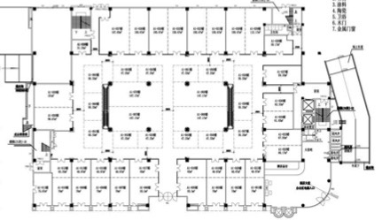


Opportunity: MAV Swarm
Deploy sensing capabilities at key areas in search & rescue
Deployment
Low Cost MAV Platform
MAV Swarm for Situational Sensing
Notes:
Using Low Cost MAV Platform consisting of miniature aerial sensors, to navigate and explore in such dangerous environments autonomously, for Situational Sensing, will provide valuable fine-grained real-time environmental information.

Slide 6
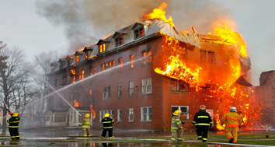
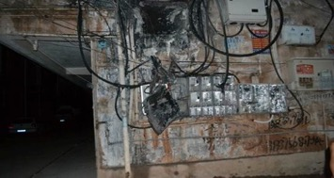

Opportunity: MAV Swarm
Safe routes?
Dangerous areas?
Locations of survivors?
Deploy sensing capabilities at key areas in search & rescue
Deployment
Low Cost MAV Platform
MAV Swarm for Situational Sensing
Notes:
This information allows rescuers, to understand the evolution, of the emergency scenarios in advance

Slide 7

Opportunity: MAV Swarm
Sensing
Dangerous
Areas
Sensing
Infrastructure
Damaged
Safe routes
Dangerous areas
Locations of survivors
Deploy sensing capabilities at key areas in search & rescue
Deployment
Low Cost MAV Platform
MAV Swarm for Situational Sensing
Notes:
Which will help them to draw up effective strategies to minimize the loss of life, and damage to property

Slide 8
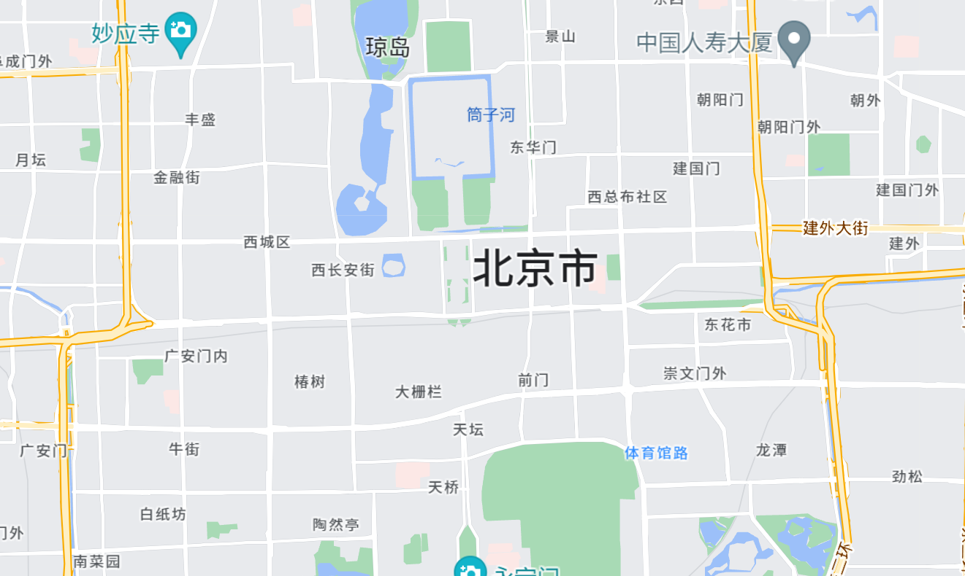
Crucial Step: Accurate localization
Accurate Localization
Deployment
Low Cost MAV Platform
MAV Swarm for Situational Sensing
Notes:
When sensing the environment, only if MAV swarm have accurate location information.

Slide 9
Crucial Step: Accurate localization
Accurate Localization
Efficient Navigation
Deployment
Low Cost MAV Platform
MAV Swarm for Situational Sensing
Notes:
Then they can navigate to a set of goal locations.

Slide 10
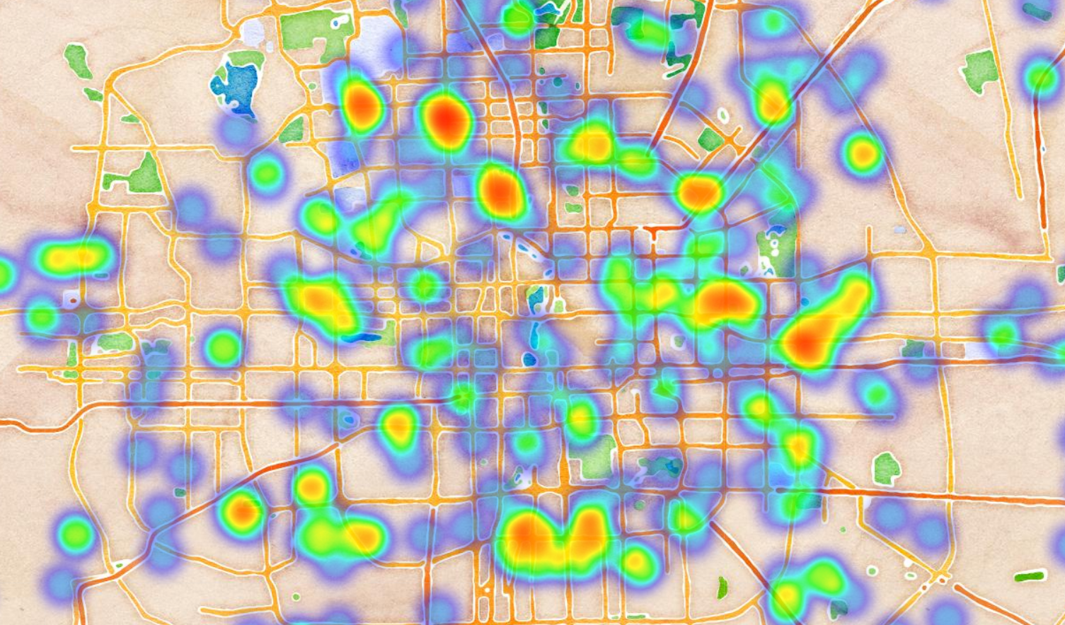
Crucial Step: Accurate localization
Accurate Localization
Efficient Navigation
Situational Sensing
Deployment
Low Cost MAV Platform
MAV Swarm for Situational Sensing
Notes:
Subsequently, they are able to collect environmental information for situational sensing.

Slide 11
Crucial Step: Accurate localization
Accurate Localization
Efficient Navigation
Situational Sensing
Deployment
Low Cost MAV Platform
MAV Swarm for Situational Sensing
Notes:
Therefore, accurate localization of the MAV swarm is a crucial step, to complete exploration in emergency scenarios.

Slide 12
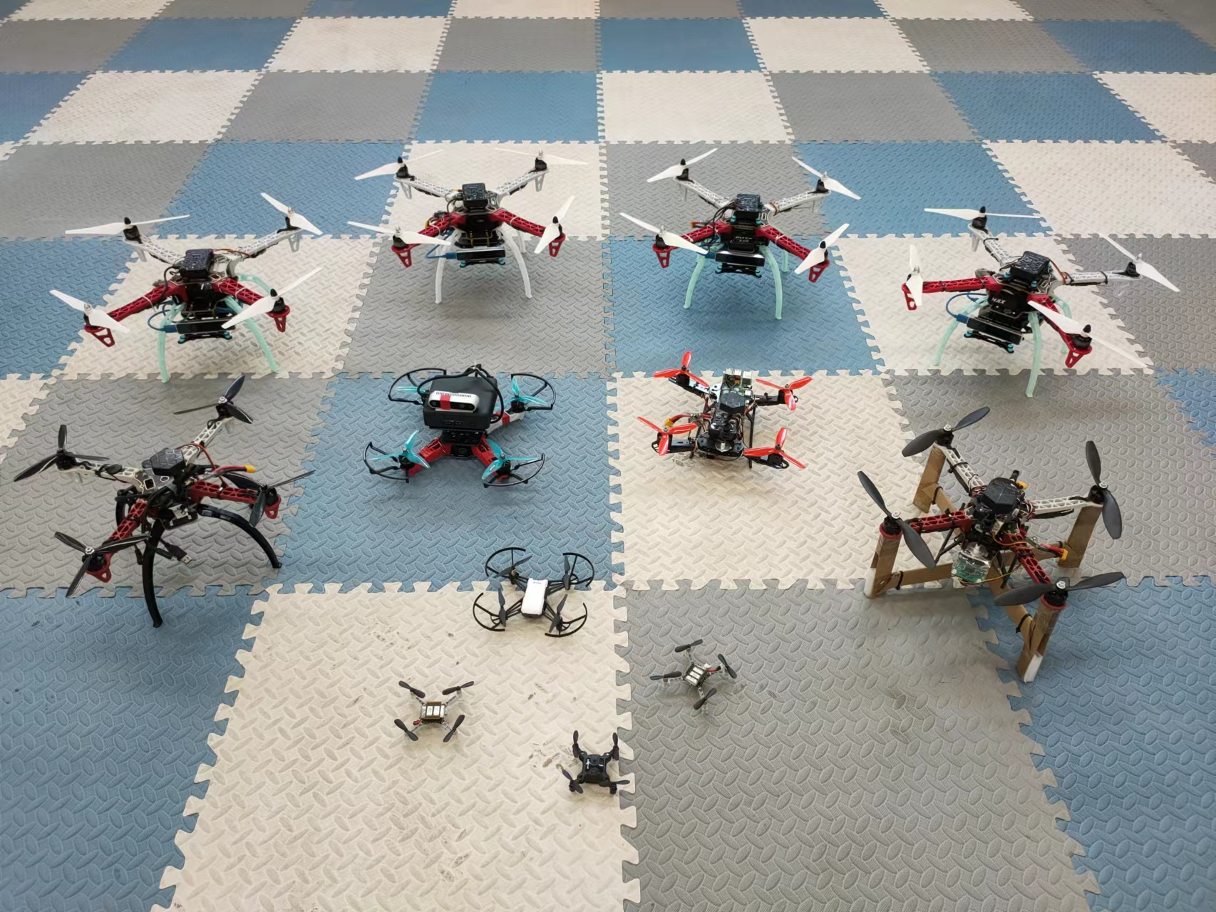
Crucial Step: Accurate localization
Onboard Capabilities
Depth cameras
Lidars
Notes:
In order to achieve this goal, there are two kinds of methods. The intuitive one is to adopt SLAM methods, with advanced sensors such as depth cameras or LiDARs, where SLAM means Simultaneous Localization and Mapping

Slide 13
Crucial Step: Accurate localization
Onboard Capabilities
Depth cameras
Lidars
×
Expensive
×
Small Scale
×
Easy to damage
Hard to be extended to large scale swarm
Notes:
However, MAVs are highly susceptible to damage, in these hazardous scenarios. To reduce overall cost, the MAV swarm usually consists of low-cost and low complexity nodes, which means these methods is hard to be extended, to large scale swarm, and this is needed in emergency scenarios to increase efficiency.

Slide 14
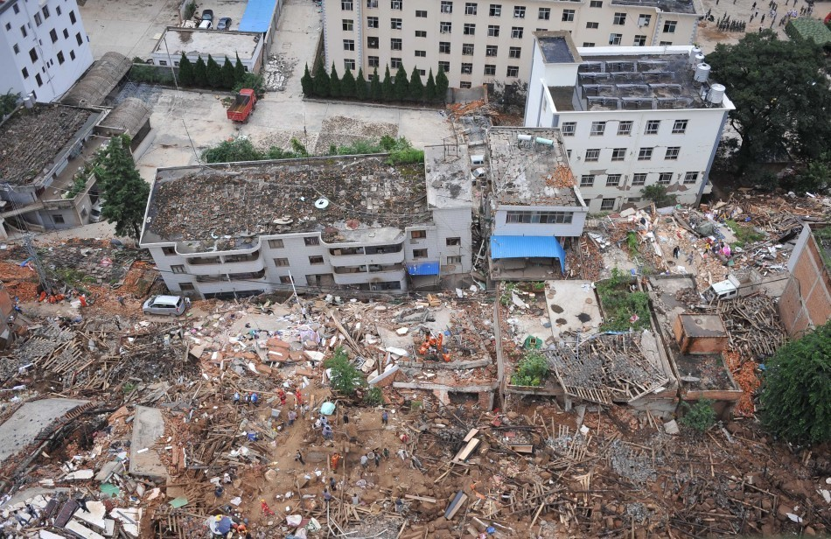
Crucial Step: Accurate localization
Onboard Capabilities
Depth cameras
Lidars
Extra Localization Infrastructure
Global Positioning System
Motion Capture System
×
Expensive
×
Small Scale
×
Easy to damage
Hard to be extended to large scale swarm
Notes:
In addition, we can use extra localization infrastructure, such as Global Positioning System and motion capture systems

Slide 15
Crucial Step: Accurate localization
Onboard Capabilities
Depth cameras
Lidars
Extra Localization Infrastructure
Global Positioning System
Motion Capture System
×
Expensive
×
Manually deploy
×
Small Scale
×
Damaged in disaster
×
Easy to damage
Hard to be extended to large scale swarm
Hard to be used in dangerous scenarios
Notes:
However, it is impossible to deploy supporting sensors, such as beacons in advance in these dangerous scenarios. Even if the localization infrastructure existed, it is highly likely damaged due to the disasters.

Slide 16
Crucial Step: Accurate localization
Onboard Capabilities
Depth cameras
Lidars
Extra Localization Infrastructure
Global Positioning System
Motion Capture System
×
Expensive
×
Manually deploy
×
Small Scale
×
Damaged in disaster
×
Easy to damage
Hard to be extended to large scale swarm
Hard to be used in dangerous scenarios
Not suitable for MAV swarm used in disaster scenarios
Notes:
Therefore, these methods are not suitable for MAV swarm, used in disaster scenarios

Slide 17
The Research Objective
Challenge 1
Challenge 2
Low-cost large-scale MAV swarm
No extra localization infrastructure
Notes:
Now, the problem we are facing, is how can Low-cost large-scale MAV swarm, in the context of No extra localization infrastructure

Slide 18
The Research Objective
Challenge 1
Challenge 2
Low-cost large-scale MAV swarm
No extra localization infrastructure
Accomplish precise localization for whole swarm
Notes:
to Accomplish precise localization for whole swarm

Slide 19
The Research Objective
Challenge 1
Challenge 2
Low-cost large-scale MAV swarm
No extra localization infrastructure
Accomplish precise localization for whole swarm
Deployment
Low Cost Tiny MAV Platform
MAV Swarm for Situational Sensing
Notes:
Subsequently, the MAV Swarm can be deployed to dangerous scenarios, to accomplish Situational Sensing of environment

Slide 20
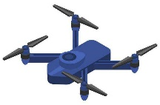

Our Proposed MAV Swarm System
Basic Components
Advanced MAV
Basic MAV
Field of View
Notes:
To solve this problem, we propose a hetegeneous MAV swarm, this system consists of two components, Advanced MAV and Basic MAV. The Advanced MAV carries a downward facing visual sensor, and has an field of view.

Slide 21
Our Proposed MAV Swarm System
Basic Components
an autonomously localize themselves
Advanced MAV
Basic MAV
Field of View
Premium capabilities
High cost
Limited capabilities
Low cost
Generates observations for
Autonomously localization
Need help for localization
Notes:
AMAV can use its Premium capabilities for automatic localization, which is high cost, while BMAV cannot, which needs other help to localize itself. AMAV can create observations for BMAV in the Field of View to help it for localization

Slide 22
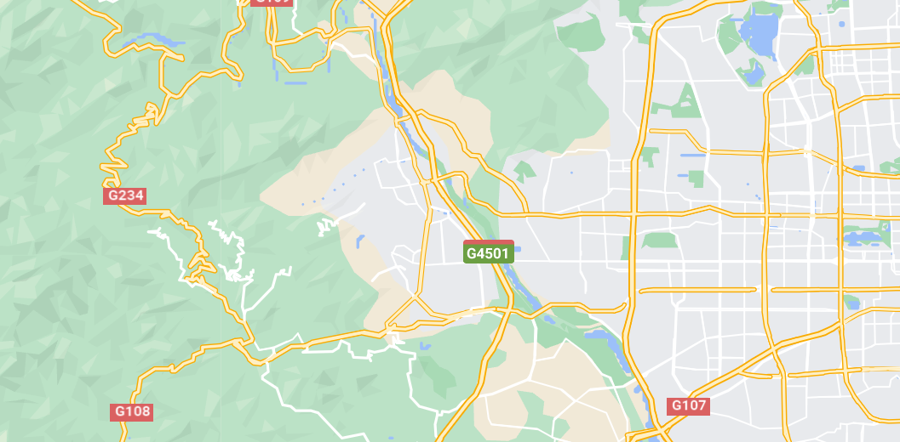
Our Proposed MAV Swarm System
Basic Components
Advanced MAV
Basic MAV
Field of View
Interaction Relationship
Notes:
In the task execution scenario

Slide 23
Our Proposed MAV Swarm System
Basic Components
Advanced MAV
Basic MAV
Field of View
Interaction Relationship
Notes:
BMAVs run in the environment

Slide 24
Our Proposed MAV Swarm System
Basic Components
Advanced MAV
Basic MAV
Field of View
Interaction Relationship
Velocity data from IMU
Notes:
BMAV can use Inertial measurement unit, to obtain its own velocity measurement with noise

Slide 25
Our Proposed MAV Swarm System
Basic Components
Advanced MAV
Basic MAV
Field of View
Interaction Relationship
Velocity data from IMU
Observation from Camera
Notes:
Utilize the observation of AMAV

Slide 26
Our Proposed MAV Swarm System
Basic Components
Advanced MAV
Basic MAV
Field of View
Interaction Relationship
Velocity data from IMU
Observation from Camera
Accurate localization
of several BMAVs
Notes:
Some BMAVs can be accurately located

Slide 27
Our Proposed MAV Swarm System
Basic Components
Advanced MAV
Basic MAV
Field of View
Interaction Relationship
Velocity data from IMU
Observation from Camera
Planning to observe BMAVs
Notes:
By planning the AMAV

Slide 28
Our Proposed MAV Swarm System
Basic Components
Advanced MAV
Basic MAV
Field of View
Interaction Relationship
Velocity data from IMU
Observation from Camera
Planning to observe BMAVs
Accurate localization of whole system
Notes:
We use a small amount of AMAV to accurately locate the entire MAV swarm. The whole MAV swarm is still low cost

Slide 29


Our Proposed Drone Swarm System
Basic MAVs
Observation Module
Advanced MAV
Observed
Observations
Pre-Processing
Observed Location
Noisy
Measure
Prediction Module
Prior
Correction Module
.....
Posterior
Estimation
Execution
Module
Motion
Commands
Planning Module
(H-SwarmLoc)
Notes:
In detail, This is our Proposed MAV Swarm System, the advanced MAV utilize observation module, prediction module, correction model and planning model to help localize basic MAVs.

Slide 30
Our Proposed MAV Swarm System
Basic MAVs
.....
Notes:
Specifically, for Basic MAVs

Slide 31
Our Proposed MAV Swarm System
Basic MAVs
Noisy Velocity
Measurement
Prediction Module
Prior
.....
Notes:
The Prediction module

Slide 32
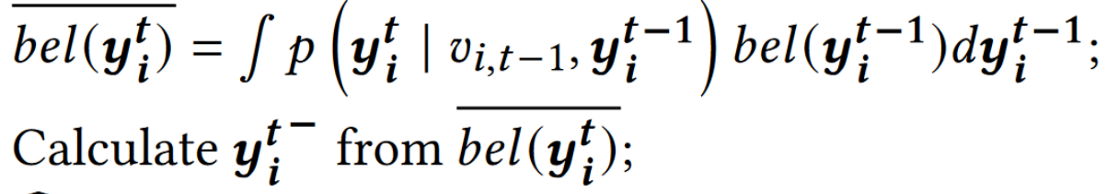
Our Proposed MAV Swarm System
Basic MAVs
Location estimation of BMAV
Velocity measurement of BMAV
Prior of BMAV
Noisy Velocity
Measurement
Prediction Module
Prior
.....
Notes:
uses the noisy velocity measurement from the BMAV and the Location estimation of BMAV to calculate prior

Slide 33
Our Proposed MAV Swarm System
Basic MAVs
Observation Module
Observed
Observations
Pre-Processing
Observed Location
Noisy Velocity
Measurement
Prediction Module
Prior
.....
Notes:
When BMAV is observed by AMAV, the Observation Module

Slide 34
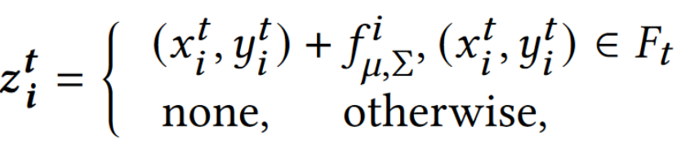
Our Proposed MAV Swarm System
Observation noise
Real location of BMAV
Basic MAVs
Observation Module
FOV
Observed
Observations
Observation of BMAV
Pre-Processing
Observed Location
Noisy Velocity
Measurement
Prediction Module
Prior
.....
Notes:
get the Observed Location of BMAV with noise

Slide 35
Our Proposed MAV Swarm System
Basic MAVs
Observation Module
Observed
Observations
Pre-Processing
Observed Location
Noisy Velocity
Measurement
Prior
Correction Module
Prediction Module
Correction Module
.....
Posterior
Notes:
Then the Correction Module

Slide 36
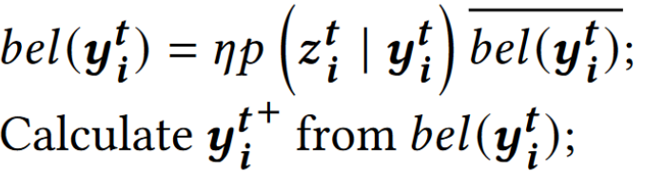
Our Proposed MAV Swarm System
Basic MAVs
Observation of BMAV
Location estimation of BMAV
Observation Module
Observed
Observations
Pre-Processing
Posterior of BMAV
Observed Location
Noisy Velocity
Measurement
Prior
Correction Module
Prediction Module
Correction Module
.....
Posterior
Notes:
utilize the observed location of BMAV and the location estimation obtained from the Prediction module to calculate the Posterior

Slide 37
Our Proposed MAV Swarm System
Basic MAVs
Observation Module
Observed
Observations
Pre-Processing
Observed Location
Noisy Velocity
Measurement
Prediction Module
Prior
Correction Module
.....
Posterior
Estimation
Execution
Module
Motion
Commands
Planning Module
(H-SwarmLoc)
Notes:
Finally, using the Posterior of BMAV, Planning Module plans the AMAV, and the Execution Module is responsible for the execute the movement

Slide 38
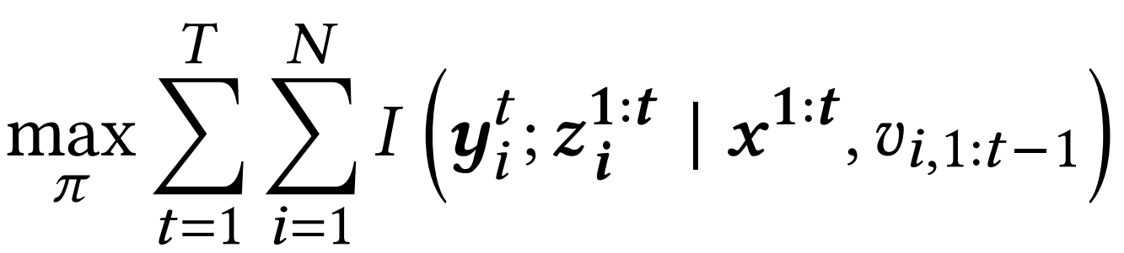
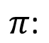
Planning Module: H-SwarmLoc
Objective: maximize mutual information between actual location and observations
$π\text{:}$
Actions sequence of AMAV
Actual location of BMAV
Observations
Location of AMAV
Velocity measurement of BMAV
Notes:
Specifically, when planning AMAV, we aim to reduce the error of BMAV location estimation. The error and uncertainty of BMAV location estimation increase at the same time. Therefore, we minimize the error of BMAV location estimation by minimizing the uncertainty of BMAV location estimation. As a measure of the reduction in uncertainty, mutual information is able to capture the statistical dependencies between two variables. Therefore, we aim to maximize mutual information between actual location and observations of BMAV

Slide 39
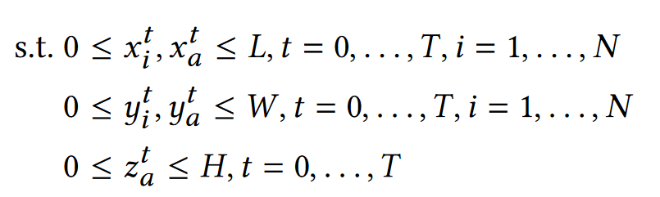
Planning Module: H-SwarmLoc
Objective: maximize mutual information between actual location and observations
$π\text{:}$
Actions sequence of AMAV
Actual location of BMAV
Observations
Location of AMAV
Velocity measurement of BMAV
Operation area constrain
Notes:
Constrains include operational area for AMAV and BMAV

Slide 40
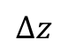
Challenges of H-SwarmLoc
Challenge 1: Inconsistent Goals
z
z
$$∆z$$
y
Scheduling
y
x
x
Notes:
Since a few of AMAVs generate observations for plenty of BMAVs, to limit the localization error, the major challenges in planning AMAVs are two folds. First, the AMAVs at a higher altitude can generate observations for more BMAVs, but higher altitude results in noisier observations.

Slide 41
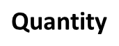
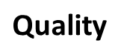
Challenges of H-SwarmLoc
Challenge 1: Inconsistent Goals
z
z
$$∆z$$
y
Scheduling
y
x
x
More observations
Noisier observation
$$\text{Q}\text{uantity}$$
Higher altitude
High Observe quantity,
Low Observe quality
Less observations
Accurate observation
Lower altitude
Observe
quantity
Contradict
Observe
quality
Low Observe quantity,
High Observe quality
$$\text{Q}\text{ua}\text{lity}$$
Notes:
The AMAVs need to balance a trade-off, between the number of BMAVs observed and the quality of the observations.

Slide 42
Challenges of H-SwarmLoc
Challenge 2: High computational cost
Scheduling
Need to limit the localization error of BMAVs for a long term
A receding horizon path-planning problem
High computational cost!
Notes:
Second, the AMAVs need to be planned, to limit the localization error of BMAVs for a long term. Therefore, the planning of AMAVs is a receding horizon path-planning problem, which usually implies the high computational cost

Slide 43
Decision Diagram of H-SwarmLoc
BMAVs
AMAV
Vision Camera
Bayes Filter
Using Bayes Filter to fuse velocity and observation
Notes:
To solve the above challenges, we first use Bayes filter to fuse velocity and observations to estimate the state of BMAV

Slide 44



Decision Diagram of H-SwarmLoc
AMAV
Vision Camera
Bayes Filter
State, $f_{s}(·)$
Policy, $π(·)$
Reward, $R(·)$
RL-based algorithm
Using RL-based algorithm to schedule the movement
Notes:
Then we plan the AMAV using a reinforcement learning-based algorithm.

Slide 45
Decision Diagram of H-SwarmLoc
BMAVs
AMAV
Vision Camera
Bayes Filter
State, $f_{s}(·)$
Policy, $π(·)$
Reward, $R(·)$
RL-based algorithm
MLP Network
Notes:
The policy is a multi layer perception network, we can use several methods to train this network.

Slide 46
Decision Diagram of H-SwarmLoc
BMAVs
AMAV
Vision Camera
Bayes Filter
State, $f_{s}(·)$
Policy, $π(·)$
Reward, $R(·)$
RL-based algorithm
MLP Network
Learn the structural characteristics of estimations
Notes:
This network can Learn the structural characteristics of estimations during the offline training

Slide 47
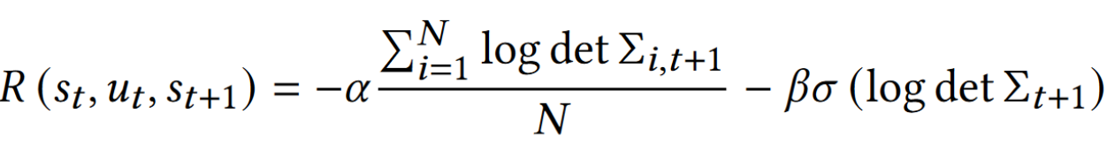
Decision Diagram of H-SwarmLoc
BMAVs
AMAV
Vision Camera
Bayes Filter
State, $f_{s}(·)$
Policy, $π(·)$
Reward, $R(·)$
RL-based algorithm
Mean uncertainty of BMAVs
Standard deviation of uncertainty
MLP Network
Notes:
the reward is formed by two parts, Mean uncertainty of BMAVs and the Standard deviation of uncertainty, which prevents the AMAV, from generating observation, for only a few BMAVs, when not all the BMAVs are within the FOV --

Slide 48
Decision Diagram of H-SwarmLoc
BMAVs
AMAV
Vision Camera
Bayes Filter
State, $f_{s}(·)$
Policy, $π(·)$
Reward, $R(·)$
RL-based algorithm
Mean uncertainty of BMAVs
Standard deviation of uncertainty
MLP Network
Plan the AMAV for a non-myopic objective
Notes:
This method maximizes a discounted sum of future rewards to handle infinite planning horizons. If u r interested, please ref to our paper for more detail

Slide 49
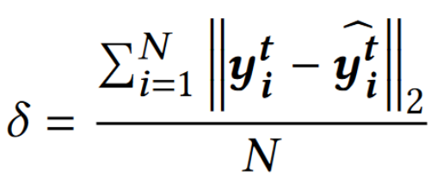
Evaluation Setup
The arena and parameters
The length 𝐿, width 𝑊 , and height 𝐻 of simulation scenario are 100𝑚, 100𝑚, 40𝑚
Three Basic MAVs and one Advanced MAV
Estimation model of the BMAV
Kalman filter is to adopted to estimate the state
Baselines
Dead-Reckoning with Map Bias (DR)
Random (RA)
Greedy (GR)
Metrics
Without AMAV
The AMAV participates in localization
Mean localization error of all BMAVs
Notes:
Then, we use simulation to verify the system and algorithm. In the simulation, Kalman filter is to adopted to estimate the state of BMAV. And Mean localization error of all BMAVs is used as metrics.

Slide 50
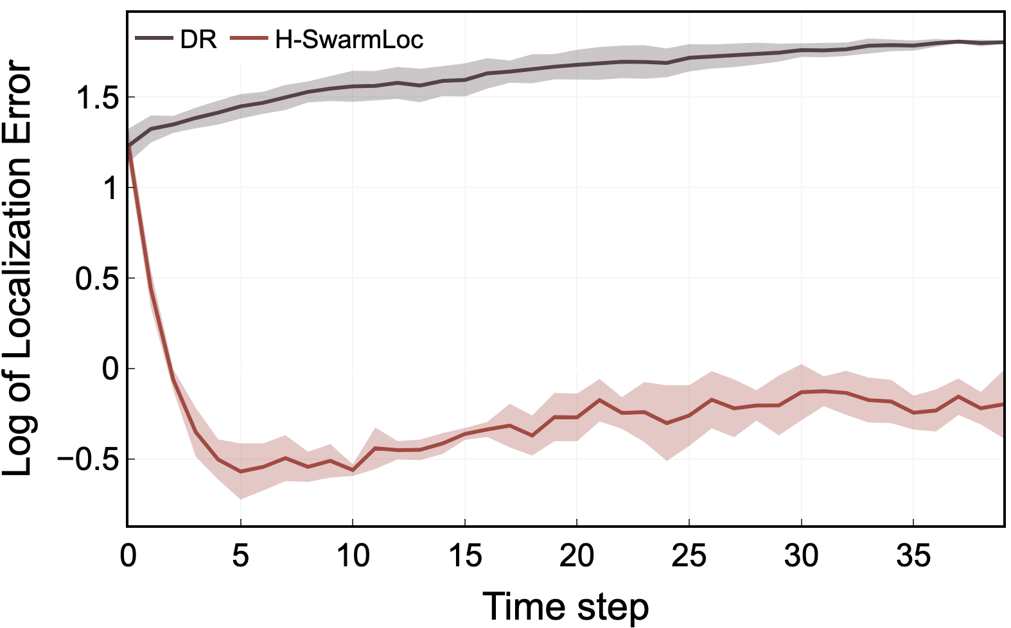
Results: The Introduction of Advanced MAV
Distance between the actual location and estimation
Notes:
To verify the performance of the introduction of the AMAV, we compare H-SwarmLoc with Dead-Reckoning. DR is an infrastructure free technique which uses noisy measurements from the accelerometer, gyroscope and optical flow from BMAVs to estimate the location.
In the beginning, both H-SwarmLoc and DR have a high localization error, because the distance between the initial actual location and location estimation of BMAVs is not zero.

Slide 51
Results: The Introduction of Advanced MAV
Distance between the actual location and estimation
Improvement 78% on average
Notes:
the localization error of H-SwarmLoc decreases by 78% on average compared to Dead-Reckoning. The localization error of DR keeps increasing, because the BMAVs have no external observation, and can only be localized by their noisy measurements. The AMAV generates observations for the BMAVs, and the localization error of BMAVs decreases and remains low.

Slide 52
Results: The Introduction of Advanced MAV
Distance between the actual location and estimation
Improvement 78% on average
The introduction of the Advanced MAV improve the localization performance
Notes:
Therefore, The introduction of the Advanced MAV improve the localization performance of whole swarm system

Slide 53
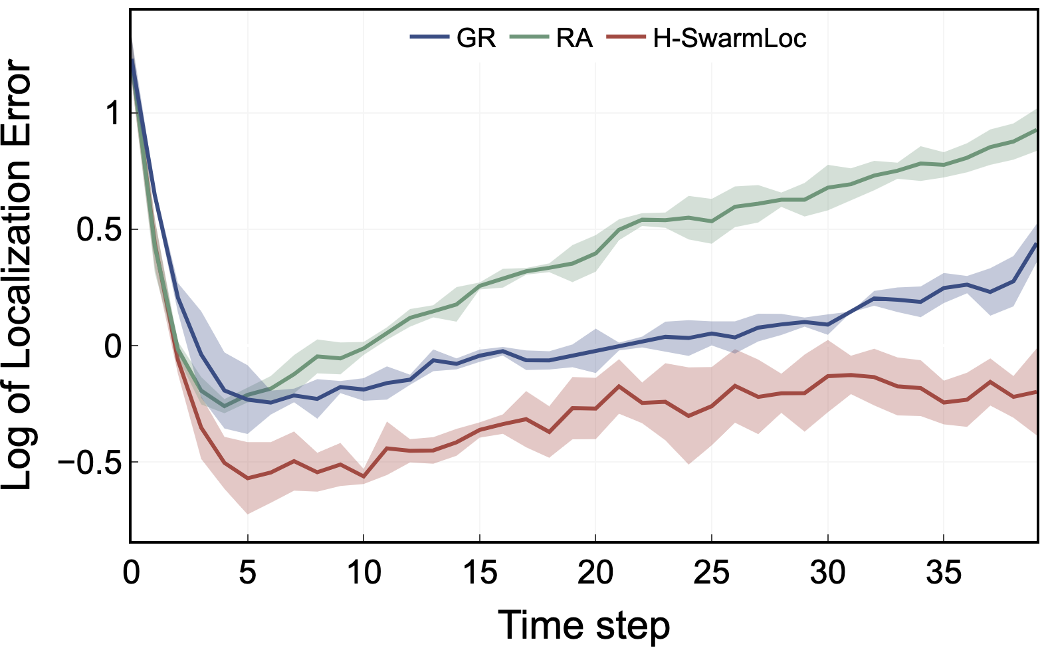
Results: Schedule Algorithm Comparation
Distance between the actual location and estimation
Notes:
Later, we compared different scheduling algorithms. At the beginning of the experiment, the localization errors of GR, RA, and H-SwarmLoc are all at a high level because there is a distance between the initial actual location and the initial location estimation of the BMAV. Subsequently, the AMAV generates observation for the BMAVs, and the distance begins to decrease.

Slide 54
Results: Schedule Algorithm Comparation
Distance between the actual location and estimation
Improvement 38% on average
Improvement 12% on average
Notes:
However, the observations generated by the AMAV for the BMAVs are different with different planning algorithms, and the localization error of the BMAVs varies. The localization error of random, greedy, and H-SwarmLoc gradually increases as time increases, but H-SwarmLoc growth slower than RA and GR. Finally, both RA and GR cannot maintain high accuracy localization for BMAVs, while H-SwarmLoc can still keep the localization error at a relatively low level.

Slide 55
Results: Schedule Algorithm Comparation
Distance between the actual location and estimation
Improvement 38% on average
Improvement 12% on average
H-SwarmLoc Plan the motions of the AMAV for the non-myopic objective
Notes:
This is because H-SwarmLoc plan the motions of the AMAV for the non-myopic objective.

Slide 56
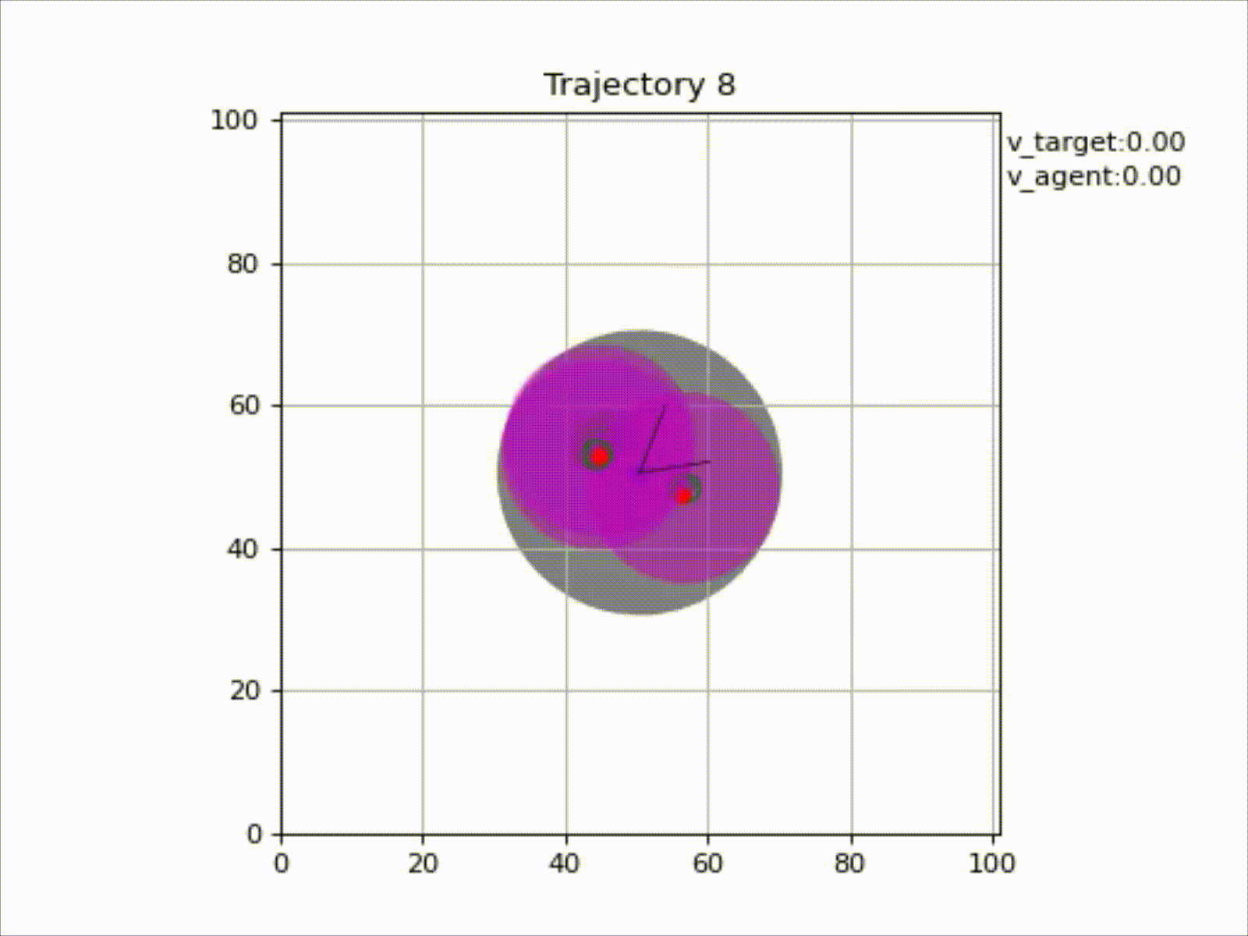
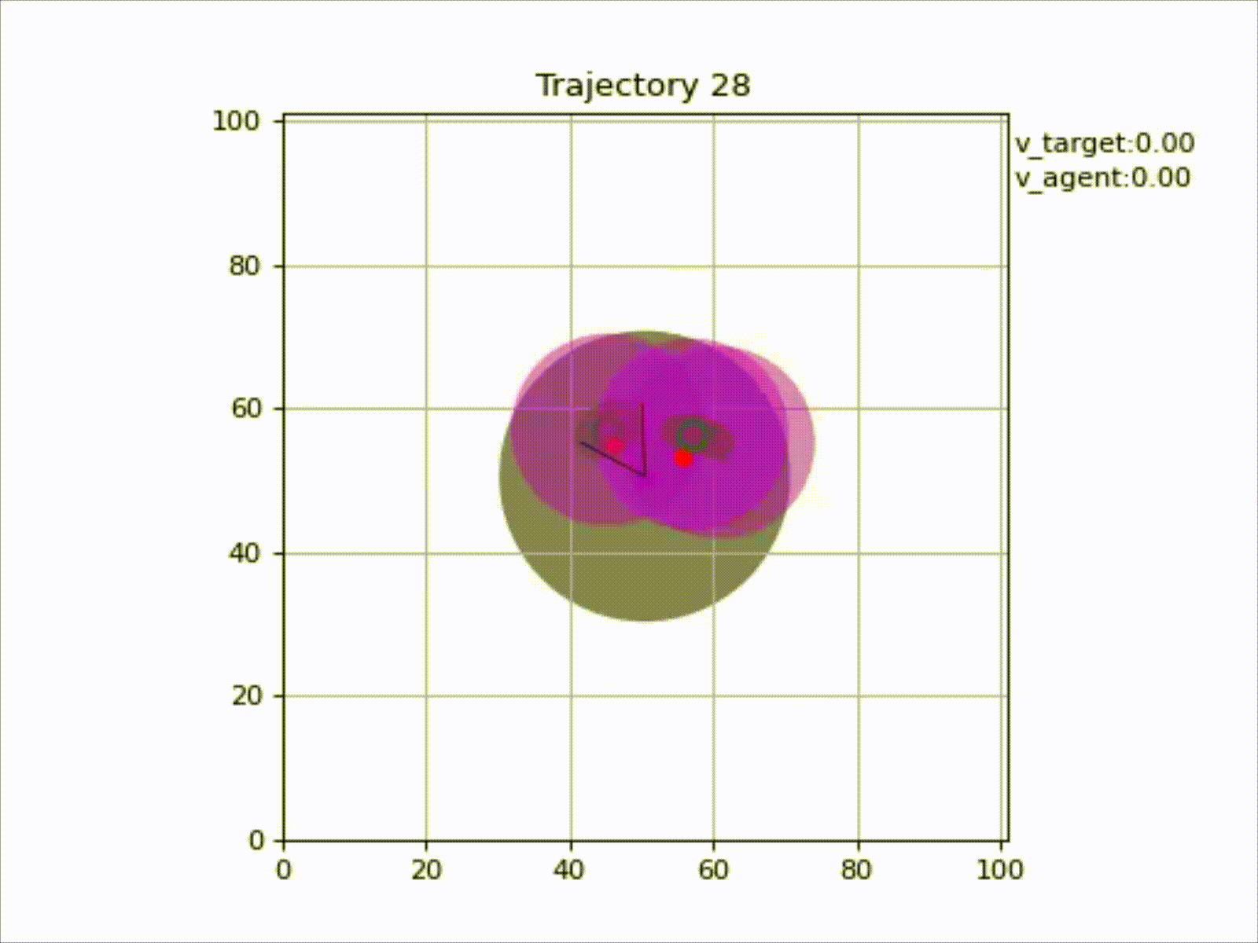
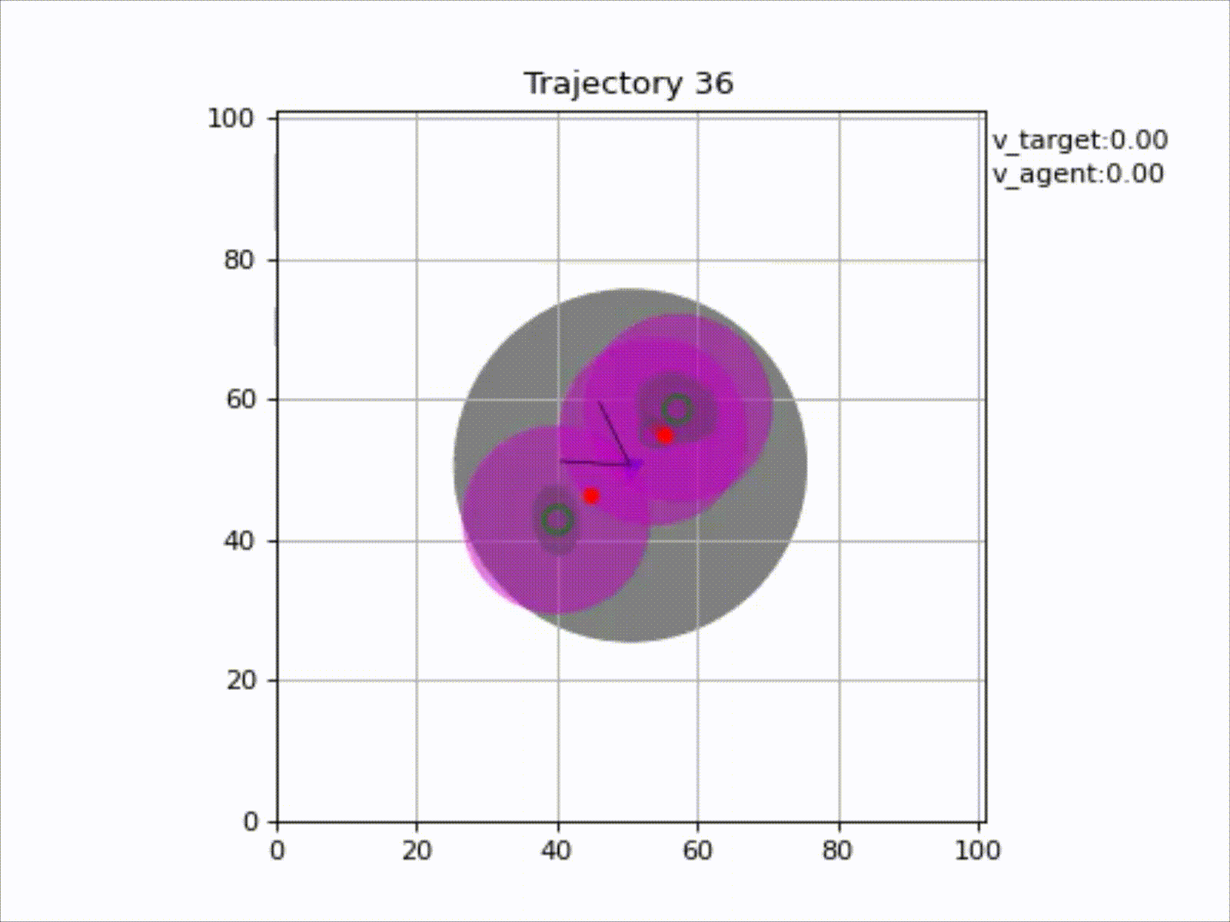
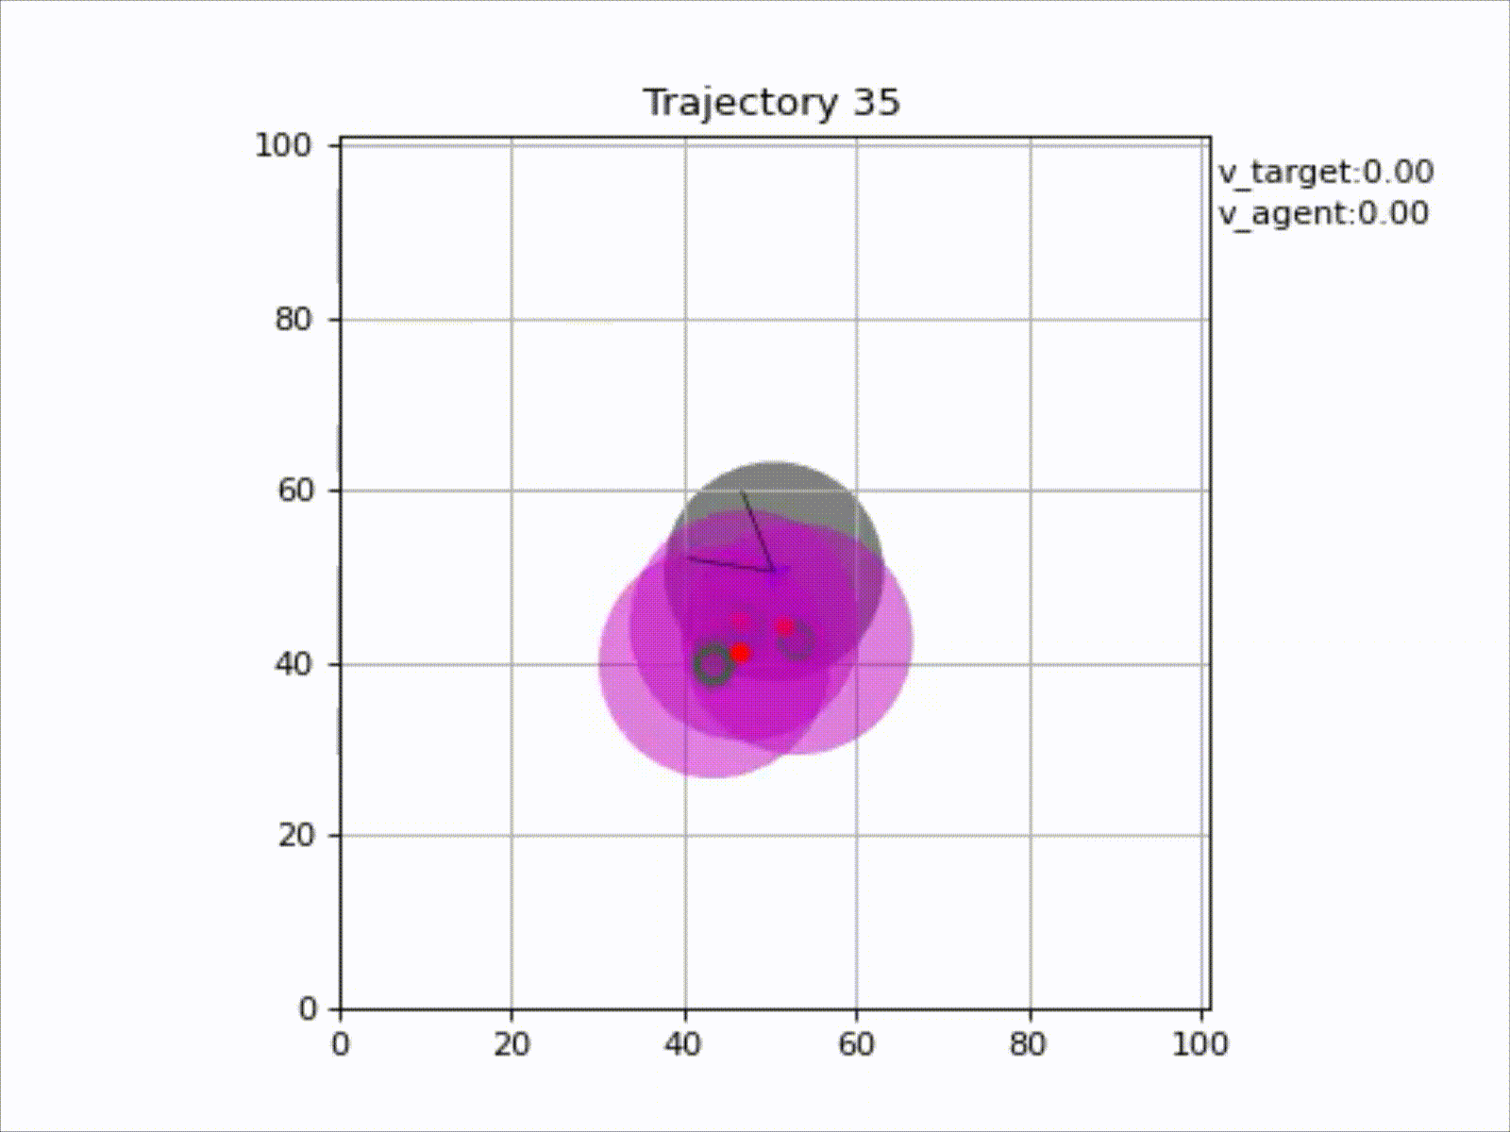
Demonstration
AMAV helps localize whole system
Notes:
Finally, based on the visualization platform, we run the simulation, the effect shows that AMAV can help locate the whole system

Slide 57
Summary of H-SwarmLoc
Propose a system to localize the low-cost heterogeneous MAV swarm accurately.
Propose H-SwarmLoc, a reinforcement learning-based planning method
Evaluate the proposed system and method with physical feature-based experiments
Notes:
Here are summary of our paper.
• Propose a system to localize the low-cost heterogeneous MAV swarm accurately and effectively by taking full advantage of AMAVs through collaboration.
• Propose H-SwarmLoc, a reinforcement learning-based planning method to schedule the AMAV for the non-myopic objective in real time to localize the MAV swarm.
• Evaluate the proposed system and method with physical feature-based experiments on the simulation platform
Finally, the future research directions of this paper include developing more robust methods to generate observation for BMAVs and planning more AMAVs to generate observation for BMAVs simultaneously.

Slide 58
Thank You!
Questions?
Presenter: Haoyang Wang, TBSI
Email: haoyang-22@mails.tsinghua.edu.cn
Notes:
Thank you very much for your attentions. Any questions will be welcomed.
the minimum hardware requirement of the AMAV is a monocular camera and an IMU which are basic requirements to execute the SLAM methods. This setting is cheap enough to balance the trade-off between the accuracy and the cost of the system. Meanwhile, it is useful to use a Stereo camera and an high-precision IMU to make the system more robust in a realistic setting.
To avoid over-dependence on localization infrastructure and advanced sensors, a few methods are proposed to provide temporary localization infrastructure by landing some MAVs. These methods require a large number of MAVs to establish temporary localization infrastructure, especially for large-scale areas

Slide 59
Decision Diagram of H-SwarmLoc
BMAVs
AMAV
Vision Camera
Bayes Filter
State, $f_{s}(·)$
Policy, $π(·)$
Reward, $R(·)$
RL-based algorithm

Slide 60
Our Proposed Drone Swarm System
Basic MAVs
Observation Module
Advanced MAV
Observed
Observations
Pre-Processing
Observed Location
Noisy
Measure
Prediction Module
Prior
Correction Module
.....
Posterior
Estimation
Execution
Module
Motion
Commands
Planning Module
(H-SwarmLoc)

Slide 61
Opportunity: Tiny Drone Swarm
Safe routes?
Dangerous areas?
Locations of survivors?

Slide 62
Demonstration
AMAV helps localize whole system

Slide 63
Challenges of H-SwarmLoc
Challenge 2: High computational cost
Scheduling
Need to limit the localization error of BMAVs for a long term
A receding horizon path-planning problem
High computational cost!

Slide 64
Our Proposed Drone Swarm System
Basic MAVs
Observation Module
Observed
Observations
Pre-Processing
Observed Location
Noisy Velocity
Measurement
Prior
Correction Module
Prediction Module
Correction Module
.....
Observation of BMAV
Real location of BMAV
FOV
Observation noise

Slide 65
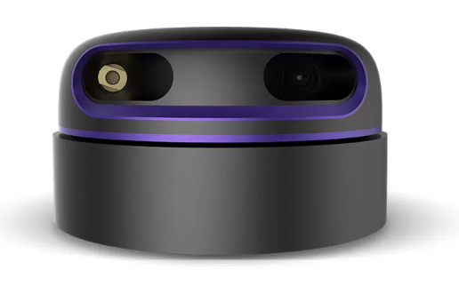

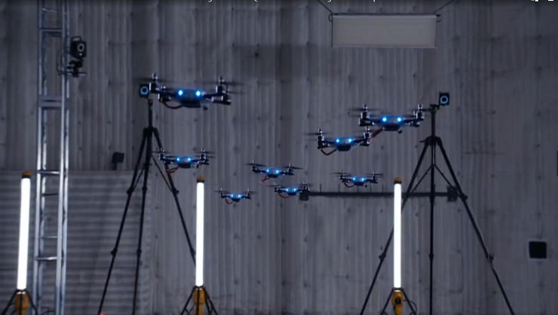
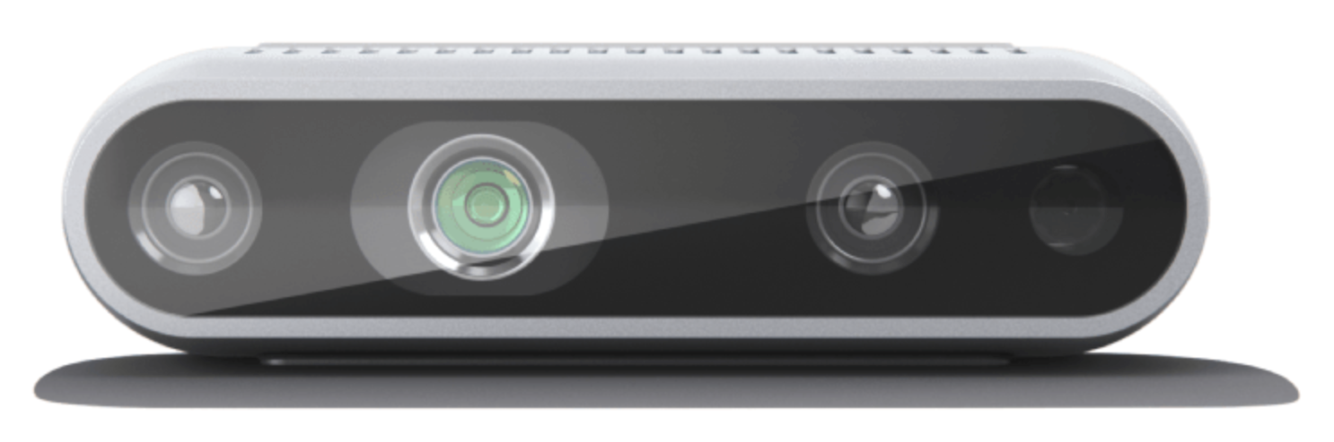
The Research Objective
Low-cost Drone Swarm
No Extra Localization Infrastructure
×
NO GPS
×
NO Motion Capture
Few Lidars
Few Depth cameras
Accomplish precise localization
Deployment
Low Cost Tiny Drone Platform
Drone Swarm for Situational Sensing

Slide 66
Our Proposed Drone Swarm System
Basic MAVs
Observation Module
Advanced MAV
Observed
Observations
Pre-Processing
Observed Location
Noisy
Measure
Prediction Module
Prior
Correction Module
.....
Posterior
Estimation
Execution
Module
Motion
Commands
Planning Module
(H-SwarmLoc)

